Slide 1
Variants of Turing Machine
CSC3113: Theory of Computation
16
10
Summer 2020-2021
Sharfuddin Mahmood, Assistant Professor,
Department of Computer Science, Faculty of Science & Technology.
smahmood@aiub.edu

Slide 2
Turing Machine (TM)
TM-computable/recognizable languages
Robustness of the Turing model
Variants of TMs
Stay Put TM
K-Tape TM
Nondeterministic TMs

Slide 3
Turing Machine (TM)
TO understand the robustness of Turing machine by its –
recognition of languages,
variants of TM, and
the equivalency of the variants with original TM.

Slide 4
All outcome are represented with examples
Students will be able to understand and compare the robustness of Turing machine through variants of Turing machine and their equivalency.

Slide 5
Accepting TMs
A Turing machine M accepts input w∈Σ* if and only if there is a finite sequence of configurations C₁, C₂, …, C_{k} with –
C₁ the starting configuration “q₀w”
for all i = 1 ,…, k–1 C_{i} yields C_{i+1} (following M’s δ)
C_{k} is an accepting configuration “uq_{A}v”
The language that consists of all inputs that are accepted by M is denoted by L(M).

Slide 6
Turing Recognizable
A language A is Turing-recognizable if and only if there is a Turing Machine M such that A = L(M).
w∈A ⟹ M halts on input w in state q_{ACCEPT},
w∉A ⟹ M halts on input w in state q_{REJECT}, or M runs forever (loop indefinitely)
Also called: a recursively enumerable language.
How do you distinguish between a very long computation and one that will never halt?

Slide 7
Turing Decidable
A language A = L(M) is decided by the Turing Machine M if M finishes in a halting configuration on every input w.
w∈A ⟹ M halts on input w in state q_{ACCEPT},
w∉A ⟹ M halts on input w in state q_{REJECT},
A language A is Turing-decidable if and only if there is a Turing Machine M that decides A.
Also called: a recursive language.

Slide 8
TM Variants
Does changing the model result in different languages being recognizable/decidable?
The original model and its reasonable variants all have the same power.
Original and variants of TM recognize the same class of languages.
Extensions to the TM do not increase the power of the TM mode.
Both finite automata and pushdown automata are somewhat robust models, but Turing machines have an astonishing level of robustness.
To illustrate the robustness of the Turing machine model, let’s vary the type of transition function permitted.

Slide 9
Stay-Put TM: Definition
Variants of Turing Machines
The head of a TM can either move left or right in the original model.
Lat us vary it by adding another move “Stay Put”, where the head does not move at all. That is, the TM may choose to move the head left or right or stay put (do not move right or left) at any moment of computation.
It is defined by the 7-tuple (Q, Σ, Γ, δ, q₀, q_{A}, q_{R}), with
Q finite set of states
Σ finite input alphabet (without “⌴”)
Γ finite tape alphabet with {⌴} ∪ Σ ⊆ Γ
q₀, q_{A}, q_{R} ∈ Q respectively the start, accept, and reject state
δ the transition function, where L = Left, R = Right, S = Stay Put δ: Q\{q_{A}, q_{R}} × Γ → Q × Γ × {L, R, S}

Slide 10
Stay-Put TM: Equivalency
Variants of Turing Machines
Now we show that, Stay Put TM recognizes the same language as original TM. It does not recognize any additional languages.
The Stay Put feature can be modeled in original TM by replacing each Stay Put transition by two consecutive transitions –
Move the head to right and
Move the head to left
These two moves in original TM will simulate the Stay Put variant TM model.
So the original TM model and the Stay Put TM model are equivalent.
Hence, they recognize the same language.
Original TM
Stay-Put TM
… | I | N | P | U | T | …
... | I | N | P | U | T | …
STAY-PUT
Move RIGHT
Move LEFT
Move RIGHT
Move LEFT
Move LEFT, Move RIGHT

Slide 11
Multitape Turing Machines: Definition
Variants of Turing Machines
A k-tape Turing machine M has k number of different tapes and read/write heads.
It is defined by the 7-tuple (Q, Σ, Γ, δ, q₀, q_{A}, q_{R}), with
Q, Σ, and Γ finite set of states, input alphabet (excluding ⌴), and tape alphabet (including {⌴} ⋃ Σ) respectively.
q₀, q_{A}, q_{R} ∈ Q respectively the start, accept, and reject state
δ the transition function δ: Q\{q_{A}, q_{R}} × Γ^{k} → Q × Γ^{k} × {L, R} ^{k}

Slide 12
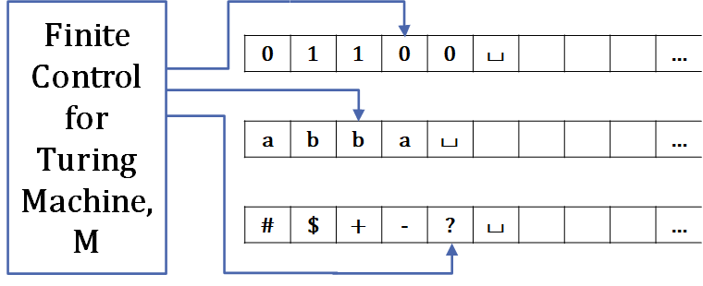
Computing with Multitape Turing Machines
Variants of Turing Machine
δ the transition function δ: Q\{q_{A}, q_{R}} × Γ^{k} → Q × Γ^{k} × {L, R} ^{k}
The expression δ(q_{i} , {a₁, . . . , a_{k}}) = (q_{j} , {b₁, . . . , b_{k}}, {L, R, . . . ,L}) means that –
If the machine
is in state q_{i} and
heads 1 through k are reading symbols a₁ through a_{k},
Then,
the machine goes to state q_{j},
writes symbols b₁ through b_{k}, and
directs each head to move left/right, as specified (here, {L, R, . . . ,L} has k directions).

Slide 13
Multitape Turing Machines: Equivalency
Theorem:
Every Multitape Turing Machine can be transformed into a single tape Turing Machine
Variants of Turing Machines
Finite Control for Turing Machine, M’
0 | 1 | 1 | 0 | 0 | ⌴ |  |  |  | …
a | b | b | a | ⌴ |  |  |  |  | …
* | $ | + | - | ? | ⌴ |  |  |  | …
Finite Control for Turing Machine, M
# | 0 | 1 | 1 | 0 | 0 | # | a | b | b | a | # | * | $ | + | - | ? | # |  |  | …
Each # symbol in M is the starting of a tape in M’. Head always points to the 1st #.
If i^{th} tape head moves in M’,
the head of M moves to the i^{th} # symbol from the left
Find and unmark the marked symbol (red+underlined, the head pointing symbol)
perform the same operation as in i^{th} head
mark the last pointing symbol and move to the 1st #.

Slide 14
k-tape TMs versus 1-tape TMs
Variants of Turing Machines
Theorem: For every multi-tape TM M, there is a single-tape TM M’ such that L(M)=L(M’). Or, For every multi-tape TM M, there is an equivalent single-tape TM M’.
From this theorem Corollary follows: A language L is TM-recognizable if and only if some multi-tape TM recognizes L.

Slide 15
Nondeterministic TM: Definition
Variants of Turing Machines
A nondeterministic Turing machine M can have several choices at every step.
It is defined by 7-tuple (Q, Σ, Γ, δ, q₀, q_{A}, q_{R}), with
Q finite set of states
Q, Σ, and Γ finite set of states, input alphabet (excluding ⌴), and tape alphabet (including {⌴} ⋃ Σ) respectively.
q₀, q_{A}, q_{R} ∈ Q respectively the start, accept, and reject state
δ the transition function δ: Q\{q_{A}, q_{R}} × Γ → 𝒫(Q × Γ × {L, R})

Slide 16
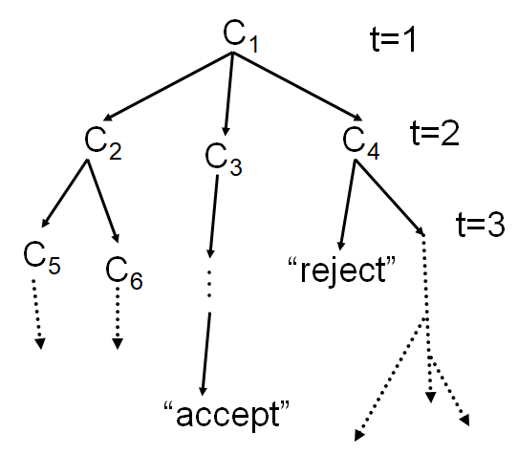
Computing with Nondeterministic TMs
Evolution of the nondeterministic TM represented by a tree of configurations (multiple path/choice)
Search every path down the tree for accepting configurations. TM accepts with at least one accepting leave.
Bad idea: “depth first”: This approach can get lost in never-halting paths.
Good idea: “breadth first”.
List all possible configurations of the non-deterministic TM as a queue.
Starting with the (start) configuration at the root (level 0; C₁), followed by all possible configuration from root configuration (level 1; C₂, C₃, C₄), followed by all possible configuration from level 1 (C₅, C₆, …), and so on.
The simulating TM accepts whenever it lists an accepting configuration.
Configuration Tree

Slide 17
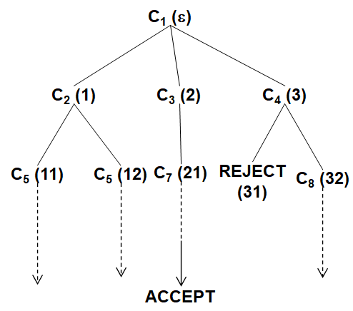
Computing with Nondeterministic TMs
Let b be the maximum number of children of a node in the configuration tree.
Any tree node can be uniquely identified by a string ∈ {1,…,b}*. Example:
Location of REJECT configuration is 31 [3rd node C₄ from root, 1st node REJECT from C₄].
Location of C₆ is 12. [1st node C₂ from root, 2nd node C₆ from C₂]
So, the selection of the nodes is done according to the lexicographical listing –
ε,
1, 2,…, b,
11,12,…,1b, 21,…,2b, …, b1,…,bb,
111,…,11b,...,1bb, b11,…b1b,…bbb,
1111, …., …., …., bbbb,
And so on…
Configuration tree with string as address

Slide 18
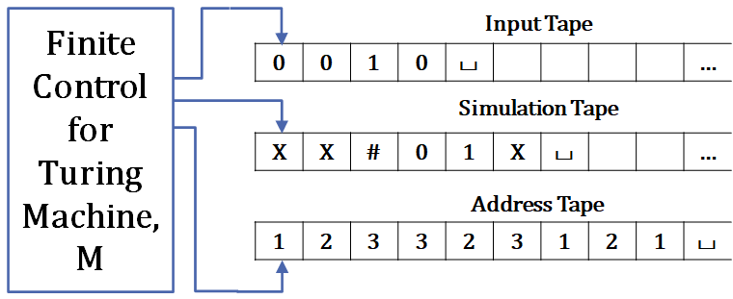
Simulating Nondeterministic TMs with Deterministic Ones
Implementing Breadth-first search in 3-tape TM
A nondeterministic TM can be simulated by 3-tape deterministic TM.
Tape 1 contains the actual input (never changed)
Tape 2 contains the simulation for the current configuration.
Tape 3 contains the address (lexicographical order of the configuration of the BFS tree) as string.
Simulation:
Copy tape 1 input to tape 2
Simulate the next configuration on tape 2 string, as per the tree order (address string) in tape 3.
If tape 3 has an accepting/rejecting configuration, halt and output accept/reject.
Otherwise continue from step 1.
Just like k-tape TMs, nondeterministic Turing machines are not more powerful than simple TMs: Every nondeterministic TM has an equivalent 3-tape Turing machine, which in turn has an equivalent 1-tape Turing machine.

Slide 19
Robustness
Just like k-tape TMs, nondeterministic Turing machines are not more powerful than simple TMs:
Every nondeterministic TM has an equivalent 3-tape Turing machine, which in turn has an equivalent 1-tape Turing machine.
Hence: “A language L is recognizable if and only if some nondeterministic TM recognizes it.”
The Turing machine model is extremely robust.

Slide 20
Computability Theory
Introduction to Theory of Computation, Sipser, (3rd ed), Variants of TM.

